Slide 1
[24SP97IN002] Formació específica d'acreditació en competència digital docent: nivell B1
Alicia De La Rasilla Ramírez
WHAT ACTIVITIES YOU DO DURING THE WEEK? © 2024 by Alicia De La Rasilla is licensed under CC BY-NC-ND 4.0

Slide 2
Recurso didáctico informativo y tecnológico
Área de conocimiento: Lengua extranjera: Inglés
Contextualización: 5º curso de Educación Primaria
Atención a la diversidad: Clase de 25 alumnos/as en la que hay tres alumnos con TDAH y un alumno con discapacidad visual
Actividad: Explicación del temario y mural colaborativo

Slide 3


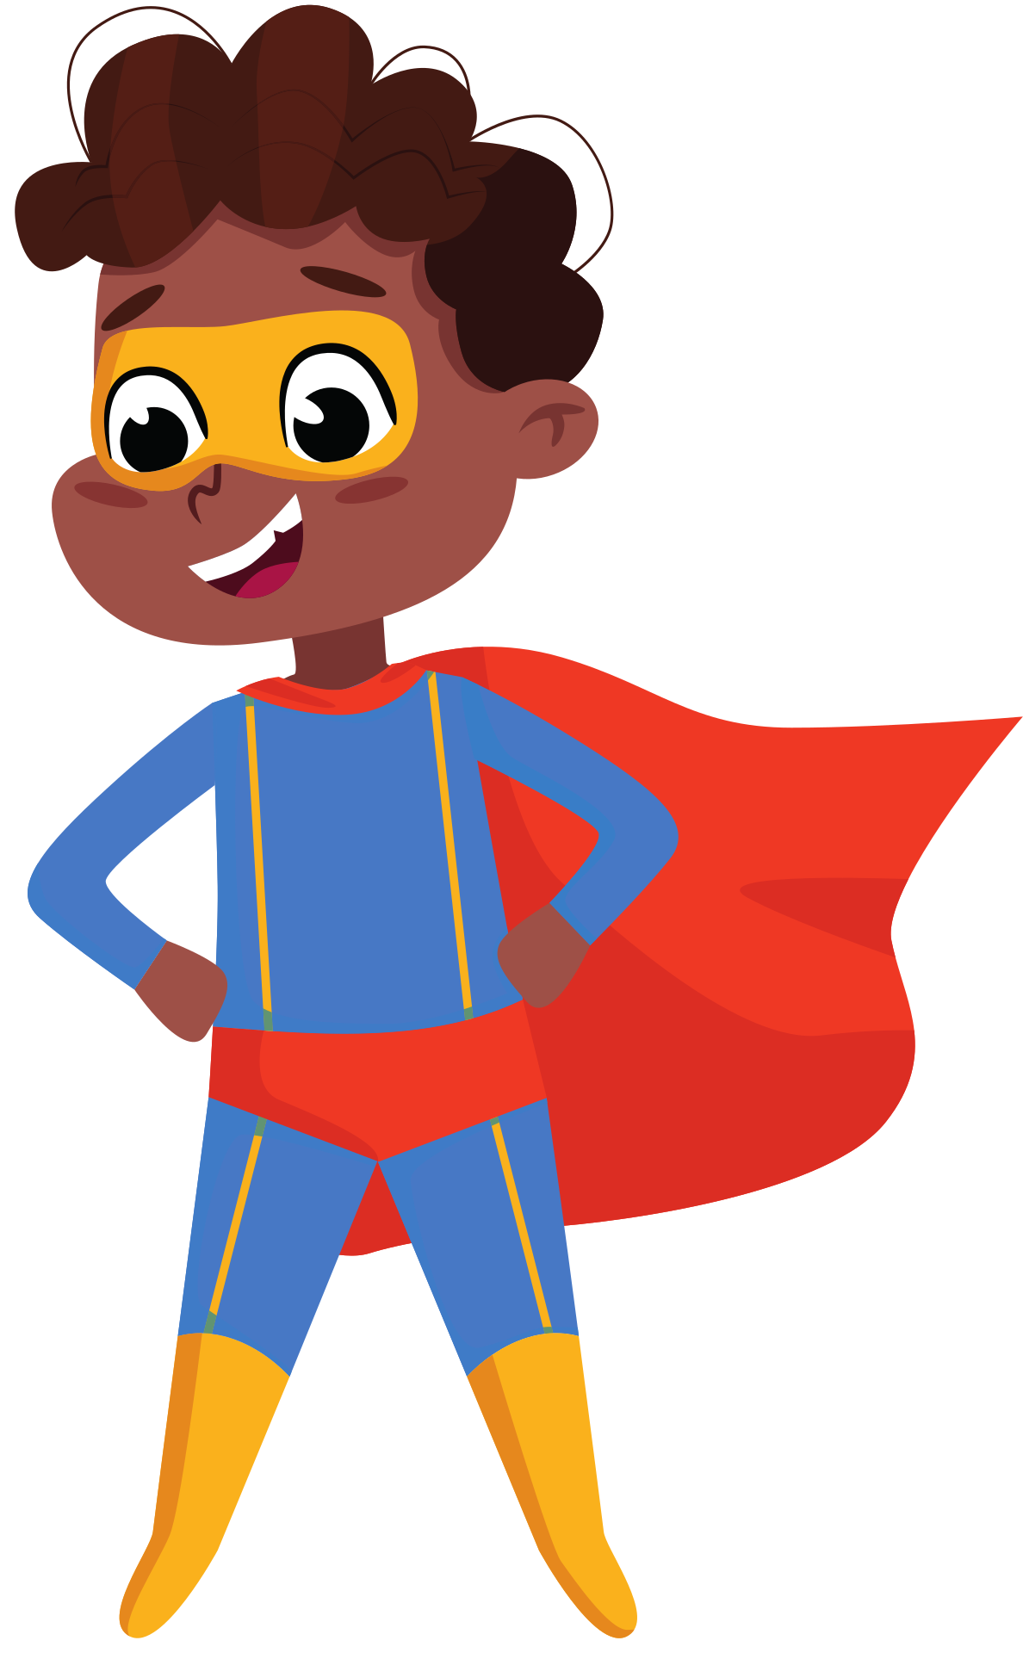
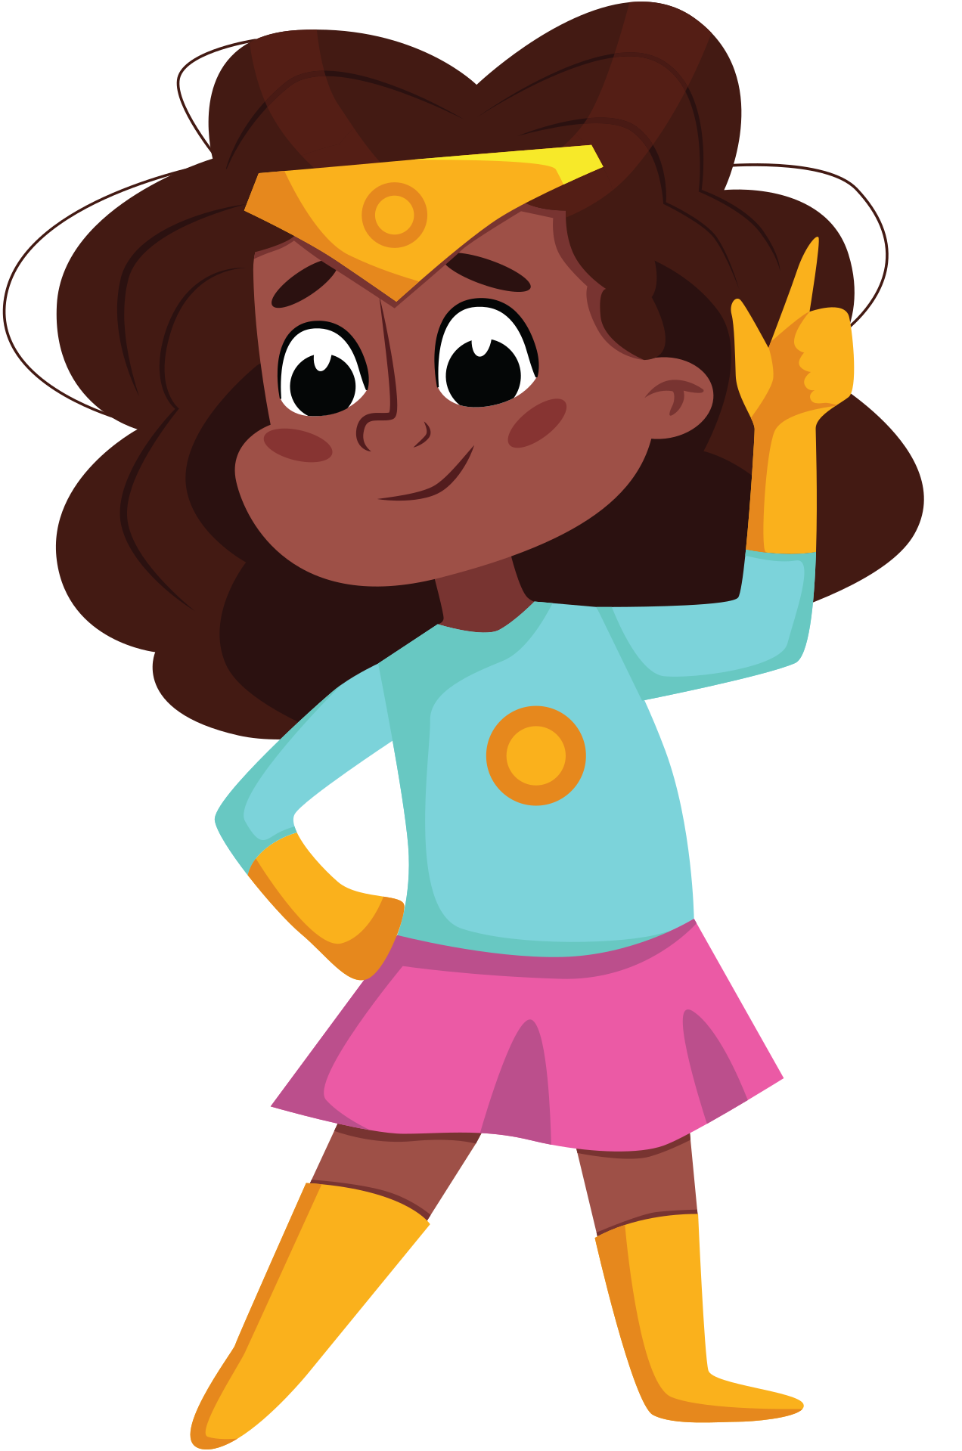
Present Simple
Present Continuous

Slide 4
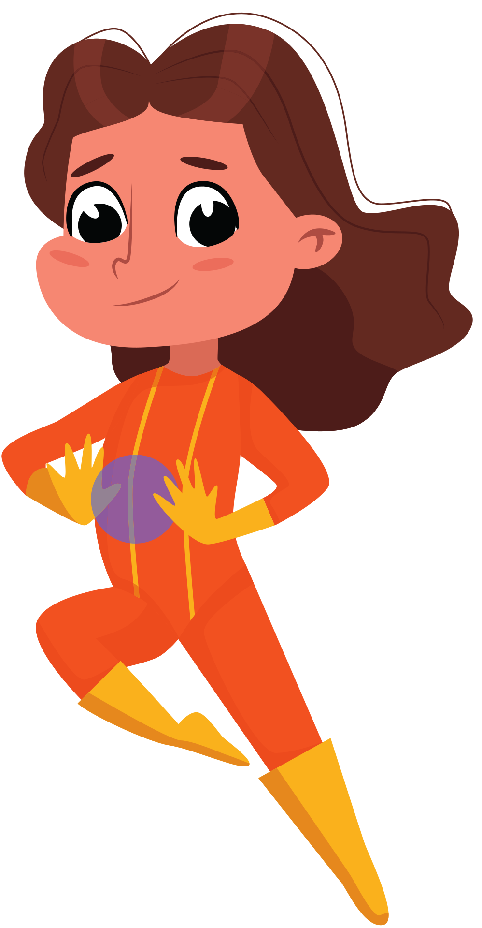
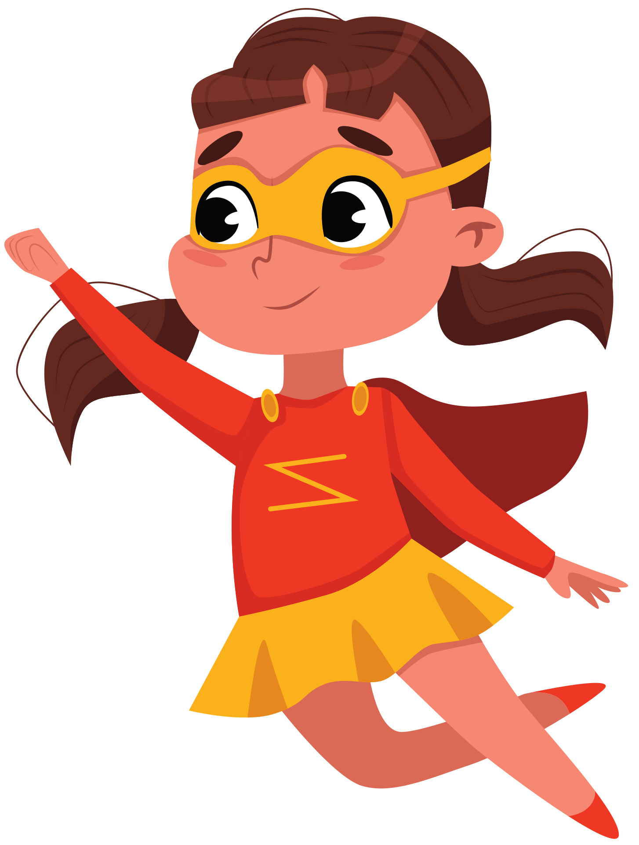
WHAT ACTIVITIES YOU DO DURING THE WEEK?

Slide 5
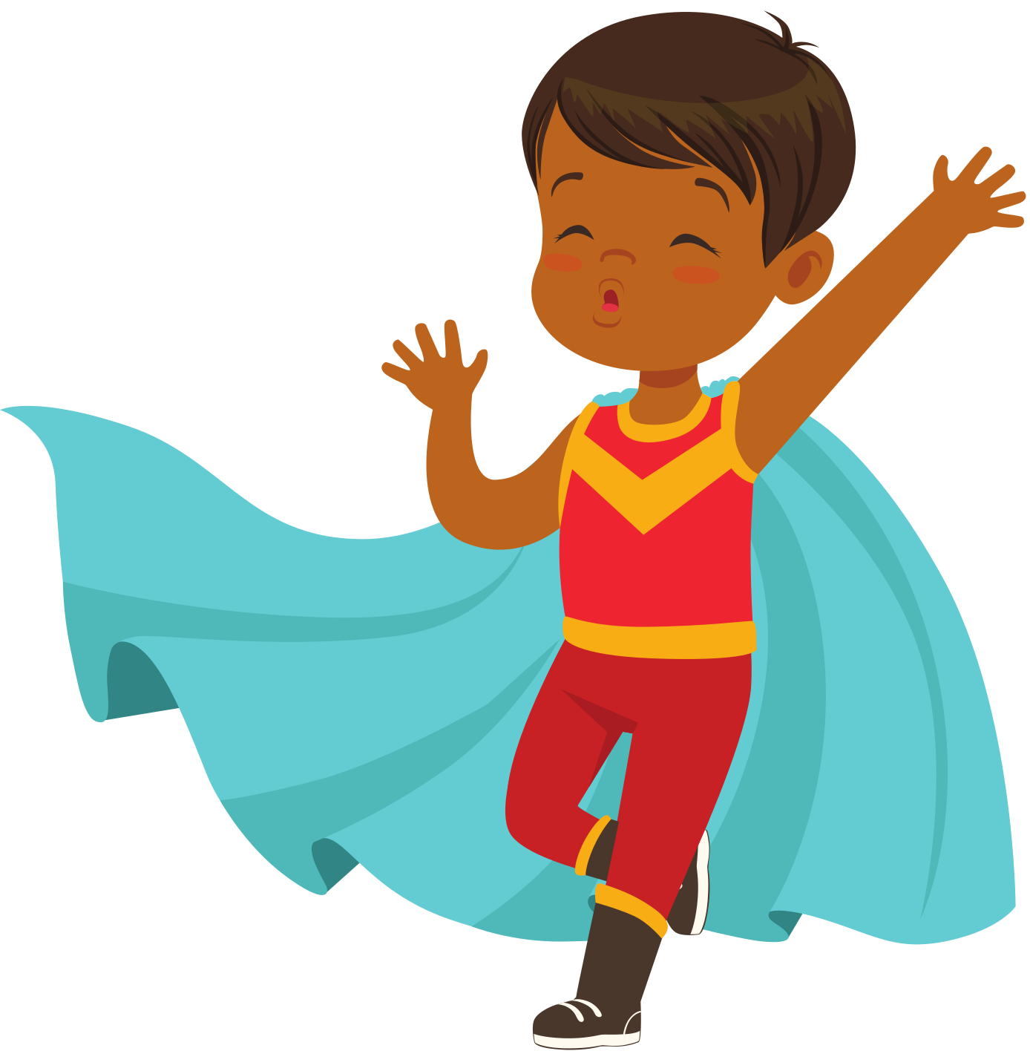
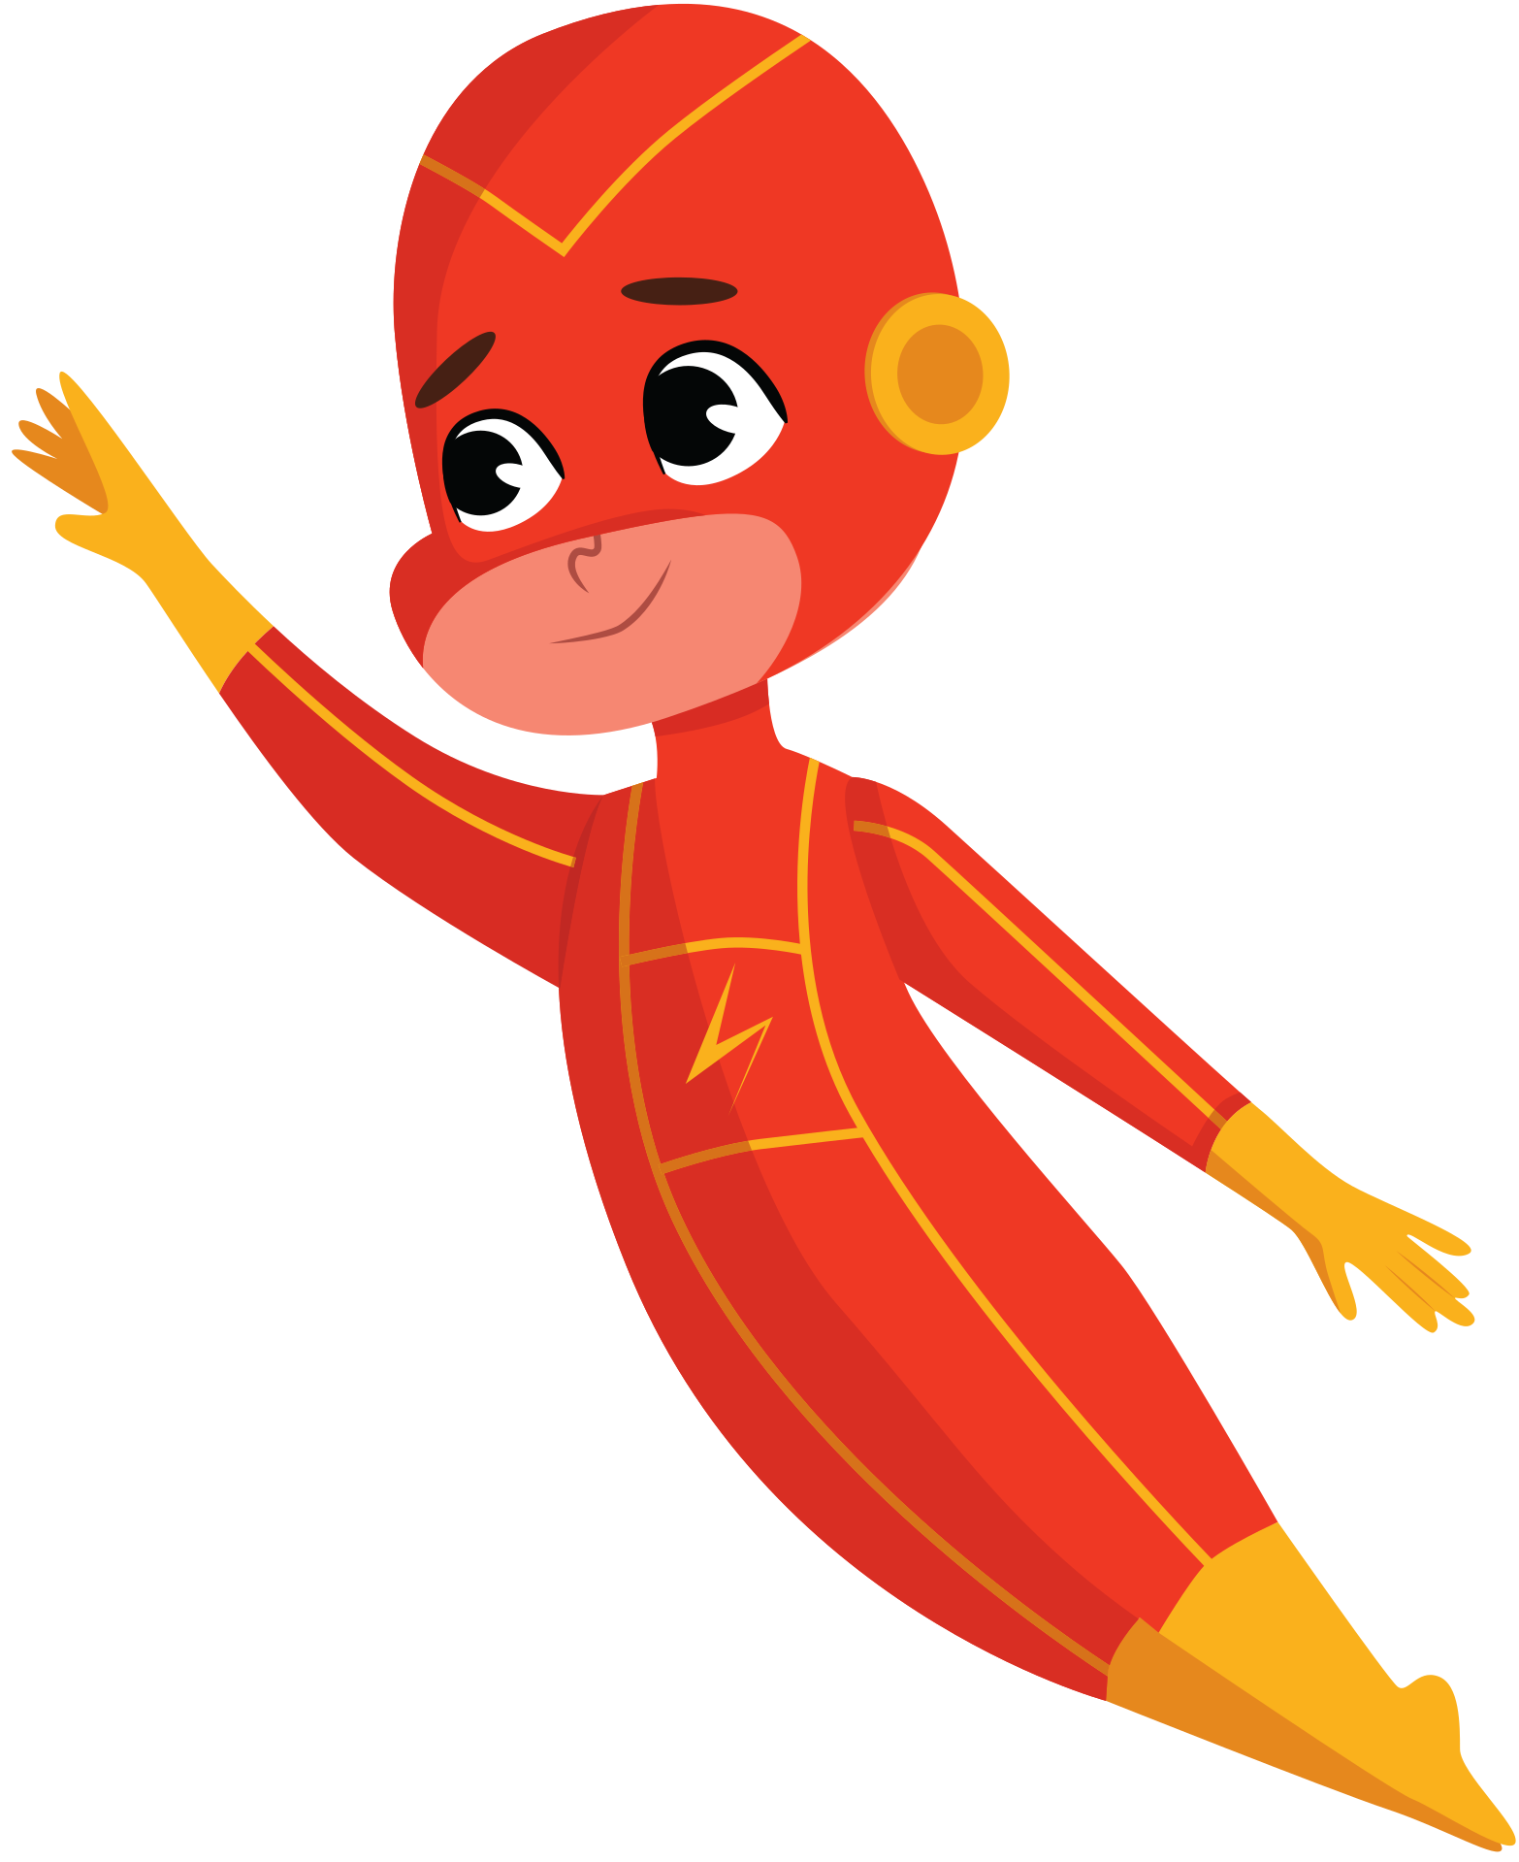
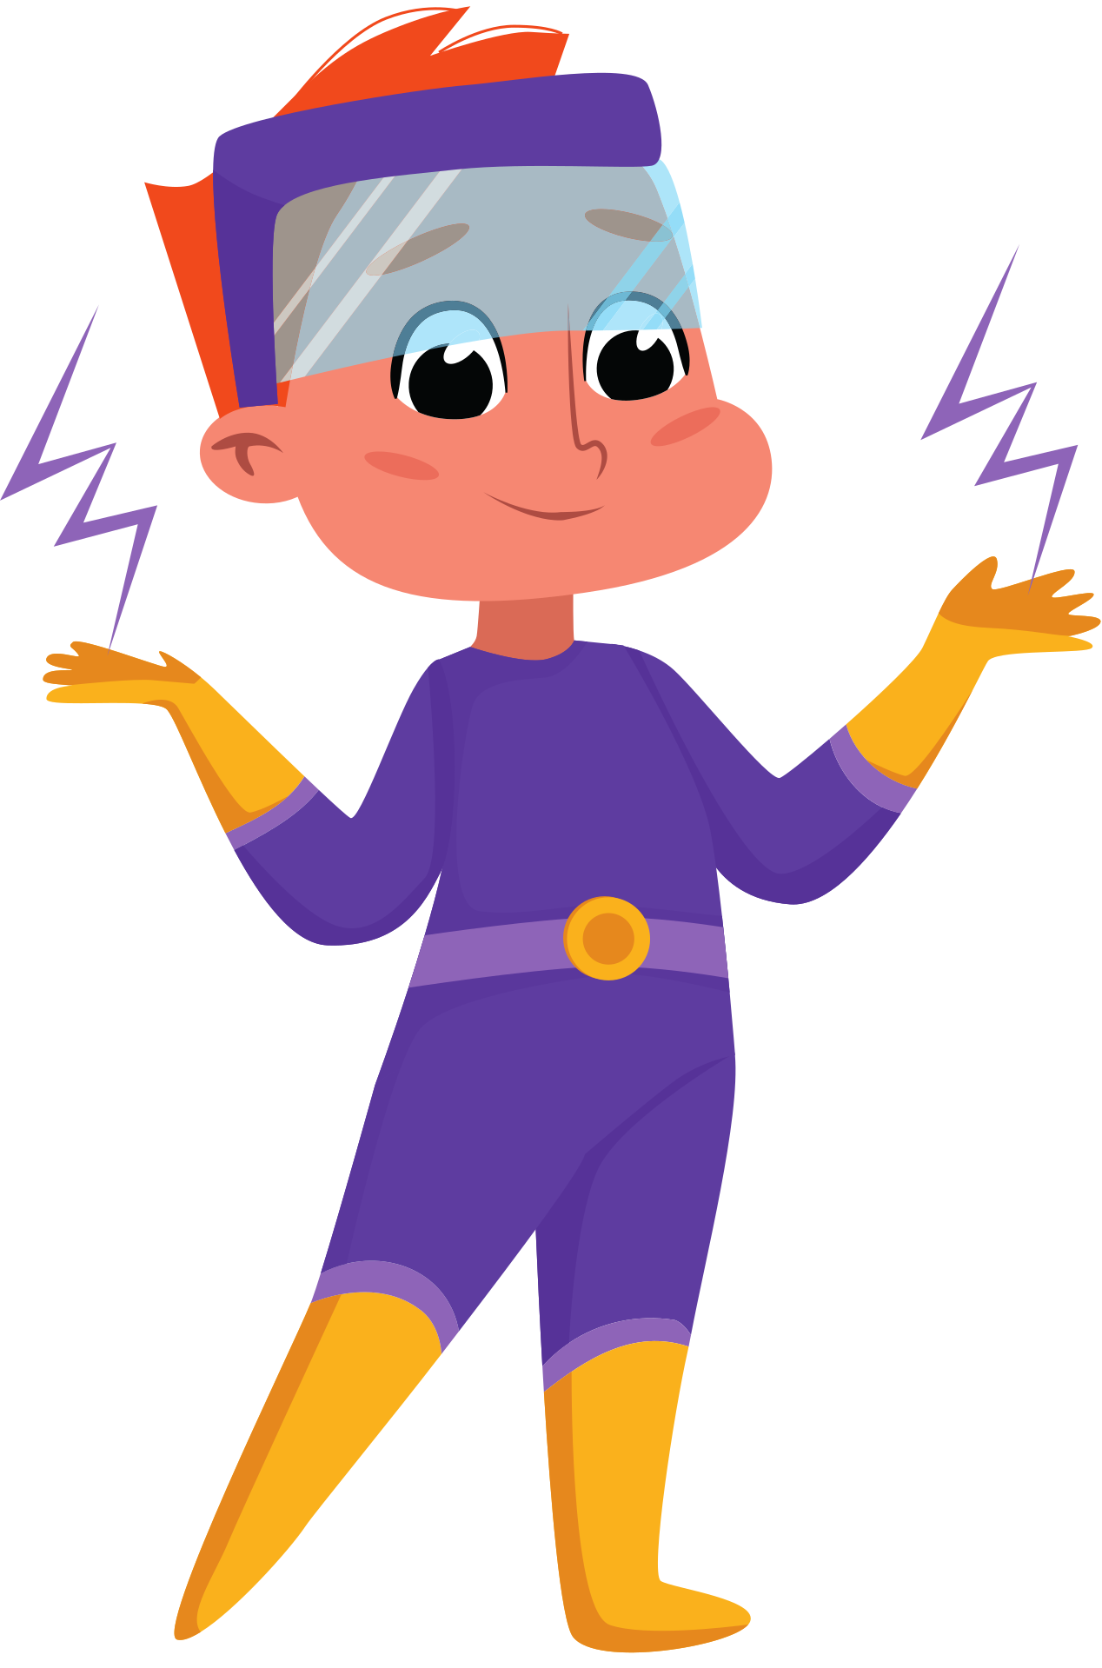
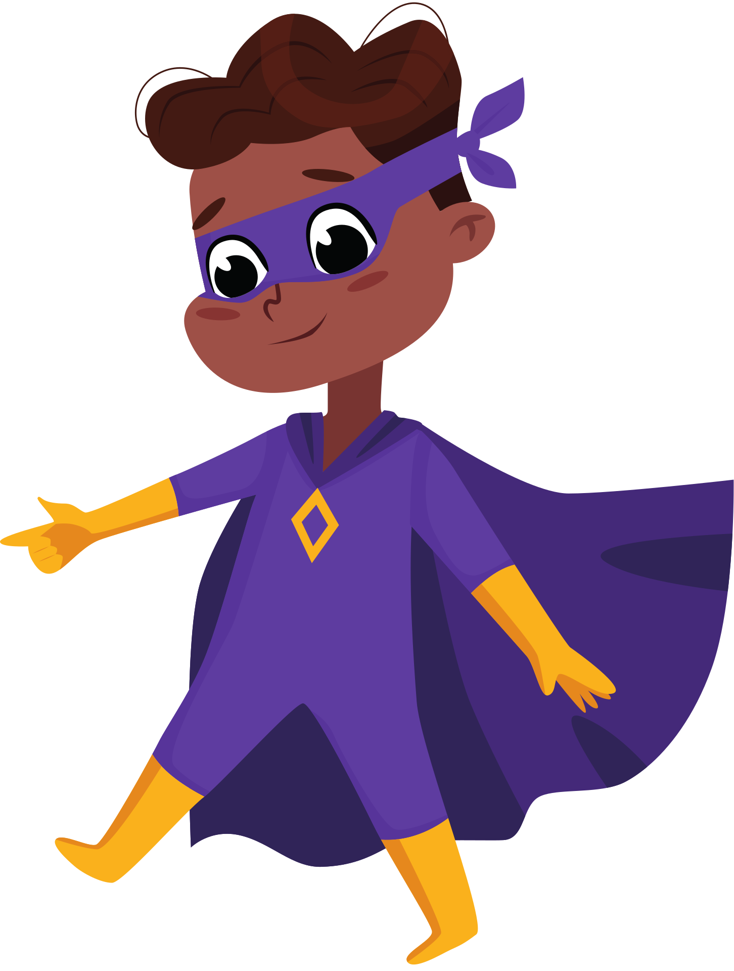

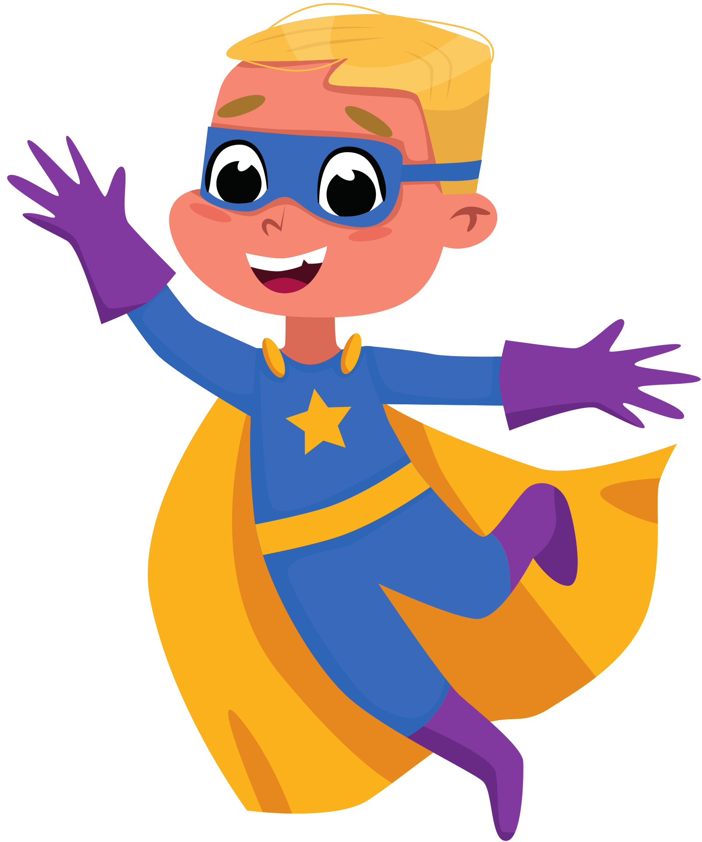
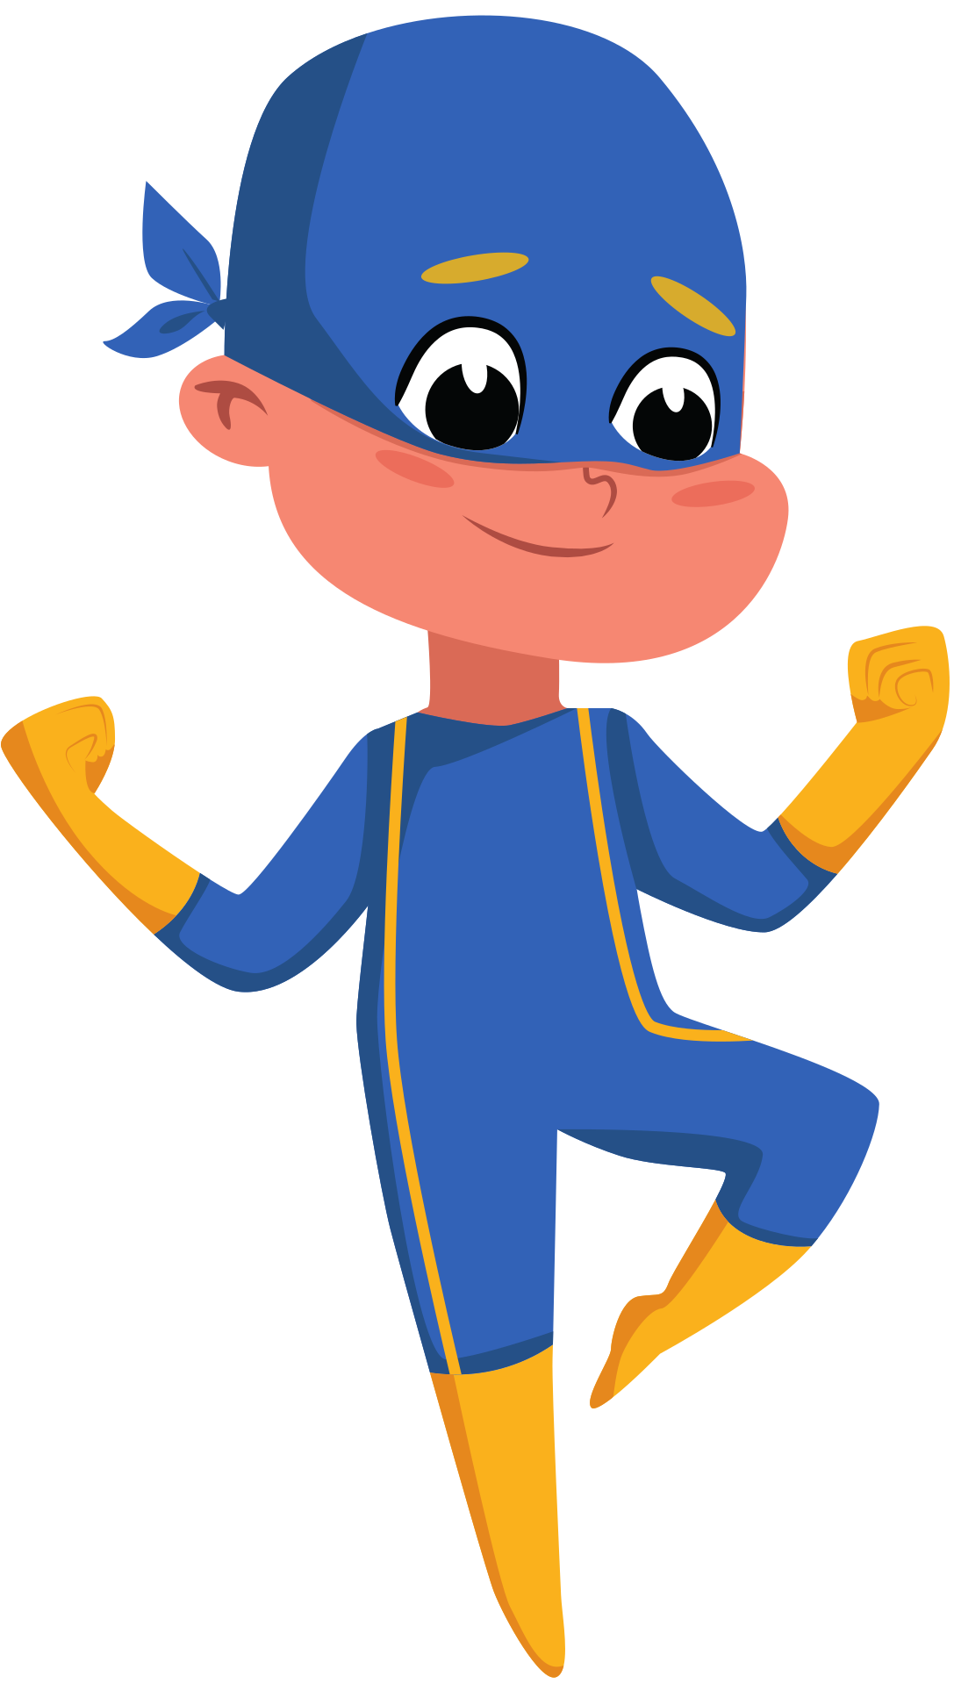
Teacher resources page

Slide 6
when do we use the Present Simple?

Slide 7
We use the present simple to talk about...
Habits and routines. Ex: I always get up at 6.
General truths. Ex: Water boils at 100°.
Timetable events. Ex: The train leaves at 9.
Permanent States. Ex: I work in a bank.

Slide 8
Present Simple
I/ you/ we/ they play
Positive
he/ she/ it plays
I/ you/ we/ they don't play
negative
He/ she/ it doesn't play
Do I/ you/ we/ they play?
questions
Does he/ she/ it play?
short answers
Yes, I do/ No, I don't
Yes, he does/ No, he doesn't

Slide 9
Common time expressions used with the present simple tense
always, often, sometimes, usually, hardly ever, never
everyday, every week, every year
once a day, twice a week, three times a year
in the morning, in the afternoon, at night

Slide 10
when do we use the Present continuous?

Slide 11
We use the present continuous to talk about...
Actions happening now. Ex: I'm listening to music at the moment.
Future arrangements. Ex: I'm meeting my friend on Saturday.
Temporary states. Ex: She's staying at a hotel this week.

Slide 12
Present continuous
I am playing
Positive
you/ we/ they are playing
he/ she/ it is playing
I'm not playing
negative
you/ we/ they aren´t playing
he/ she/ it isn't playing
Am I playing?
questions
Are you/ we/ they playing?
Is he/ she/ it playing?
short answers
Yes, I am/ No, I'm not
Yes, we are/ No, we aren´t
Yes, she is/ No, she isn´t

Slide 13
Common time expressions used with the present continuous tense
now, right now
at the moment
this week, this year, this month

Slide 14
Activity explanation
Make groups of 5 students
Write your routines and the activities you are going to do this week and weekend, using the present simple and present continuous
Choose one activity per day and write it in padlet
Add a picture to every activity you write

Slide 15


LET’S CREATE OUR OWN TIMETABLE IN PADLET!

